Slide 1

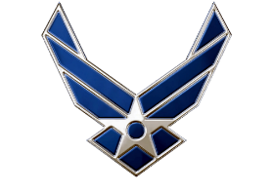
LRC’s Spring ‘25
Air Force ROTC Detachment 842
The University of Texas at San Antonio
C/2d Lt Nephi Acevedo
27 Feb 25

Slide 2


Overview
Timeline
Locations
Required Items
Parking
Transition/Groups
Rotations
UOD
Safety/Execution
Air Force ROTC Detachment 842 • We Build Exceptional Officers • The University of Texas at San Antonio

Slide 3
Timeline (TBD)
Cadets will arrive at Brackenridge lot NLT 0700
Cadets will depart to Lackland AFB at 0730
Cadets will arrive at Lackland AFB at 0800
LRCs will begin at 0830
LRCs will end at 1200
Cadets will depart to UTSA at 1210
Air Force ROTC Detachment 842 • We Build Exceptional Officers • The University of Texas at San Antonio

Slide 4
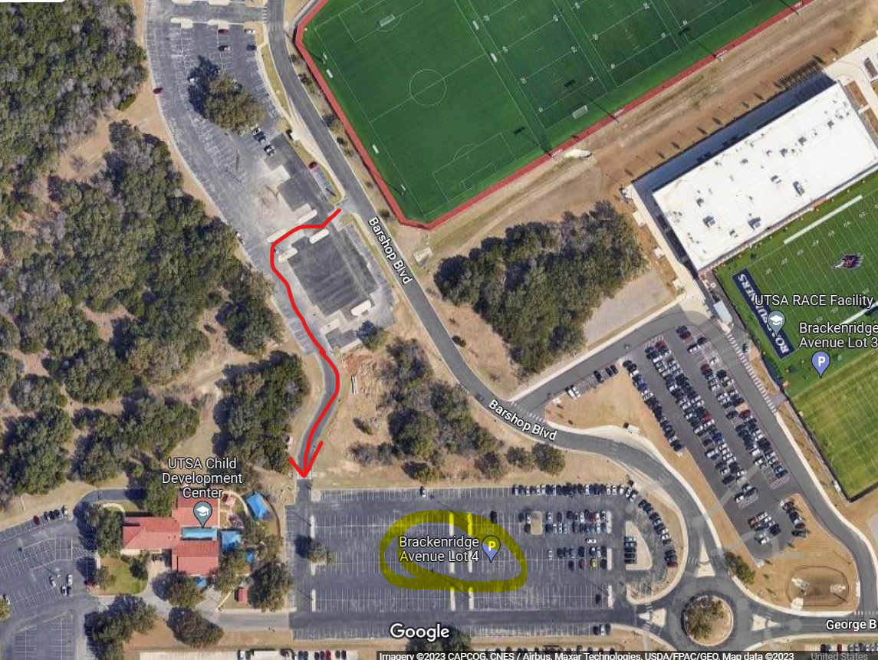
Locations
Cadets will arrive at Brackenridge lot 4. at 0700.
POC Flight Commanders will take accountability and check required items
GMC will separate into carpool groups and depart to Lackland AFB at 0730
Air Force ROTC Detachment 842 • We Build Exceptional Officers • The University of Texas at San Antonio

Slide 5
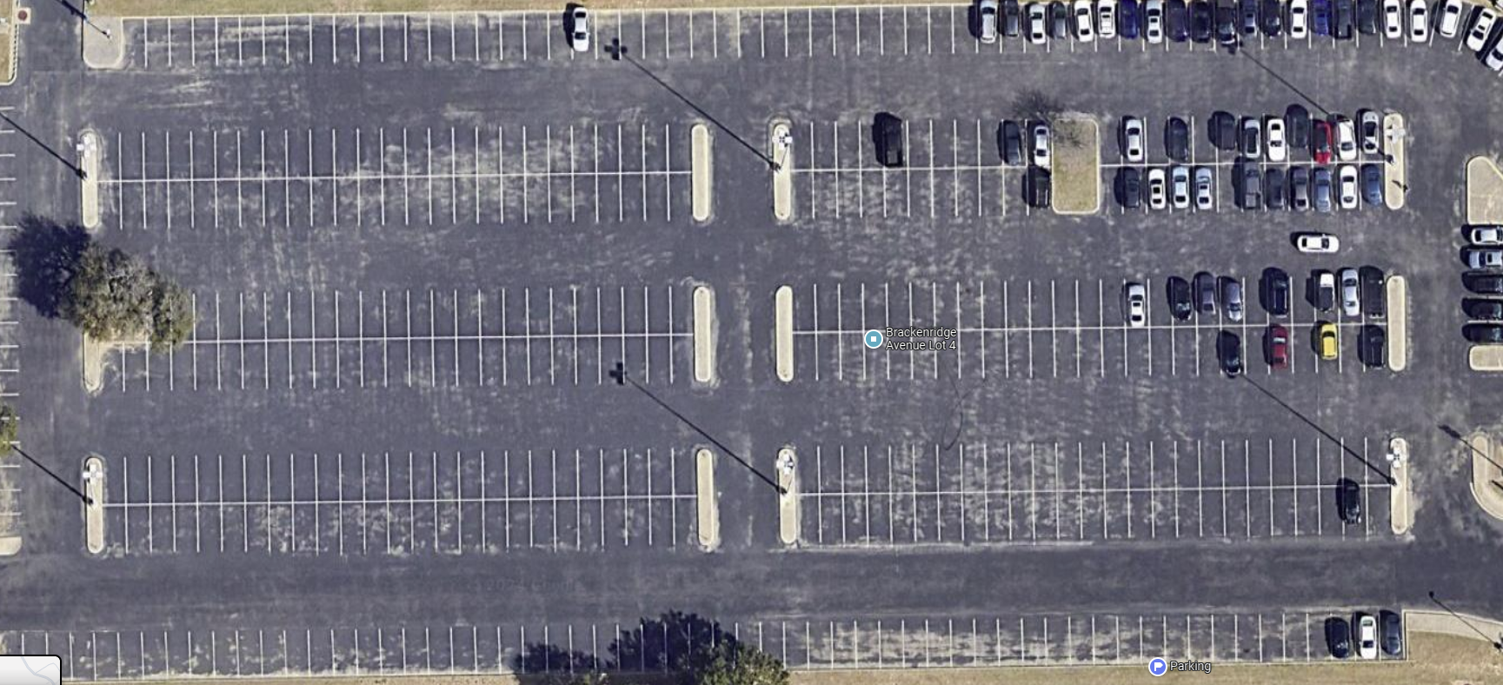
Locations
Alpha
Bravo
Whiskey
Charlie
X-Ray
Delta
Yankee
Air Force ROTC Detachment 842 • We Build Exceptional Officers • The University of Texas at San Antonio

Slide 6
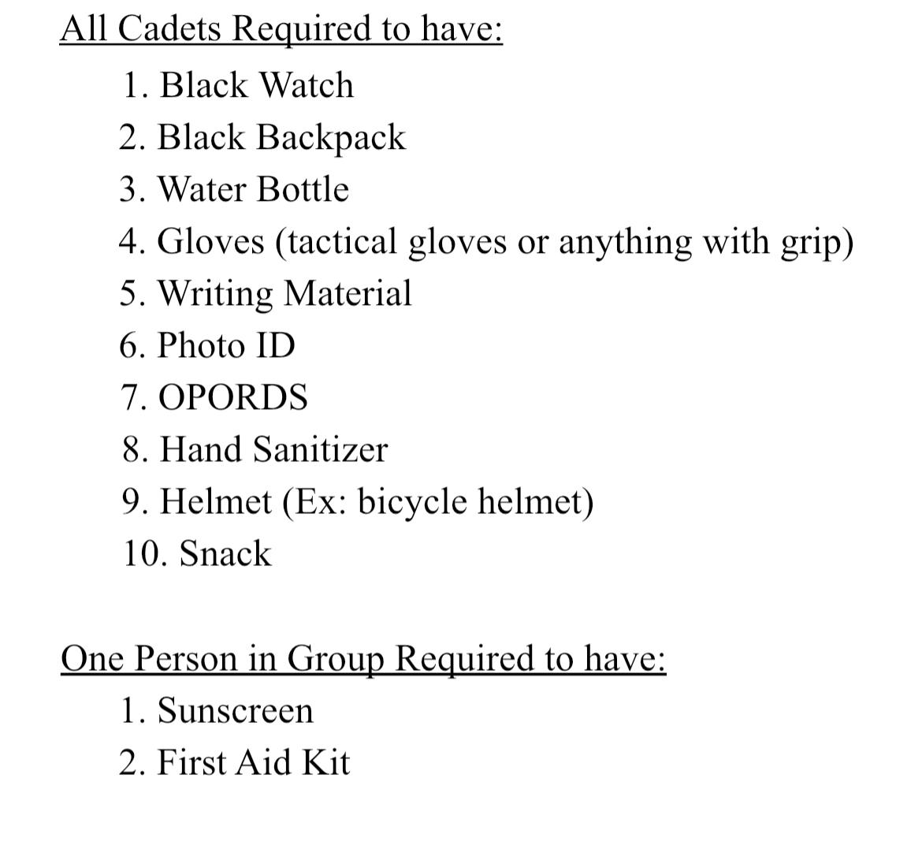
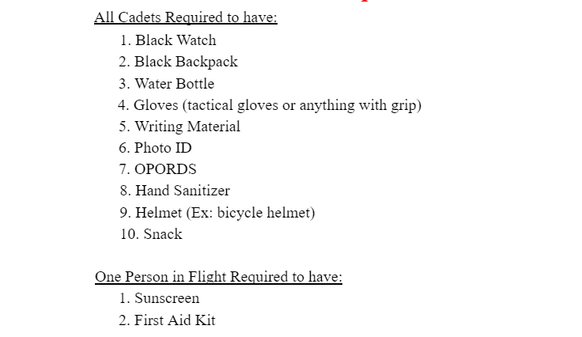
Required Items
Required items will be checked prior to transitioning to Chapman Annex by your flight commander
Air Force ROTC Detachment 842 • We Build Exceptional Officers • The University of Texas at San Antonio

Slide 7
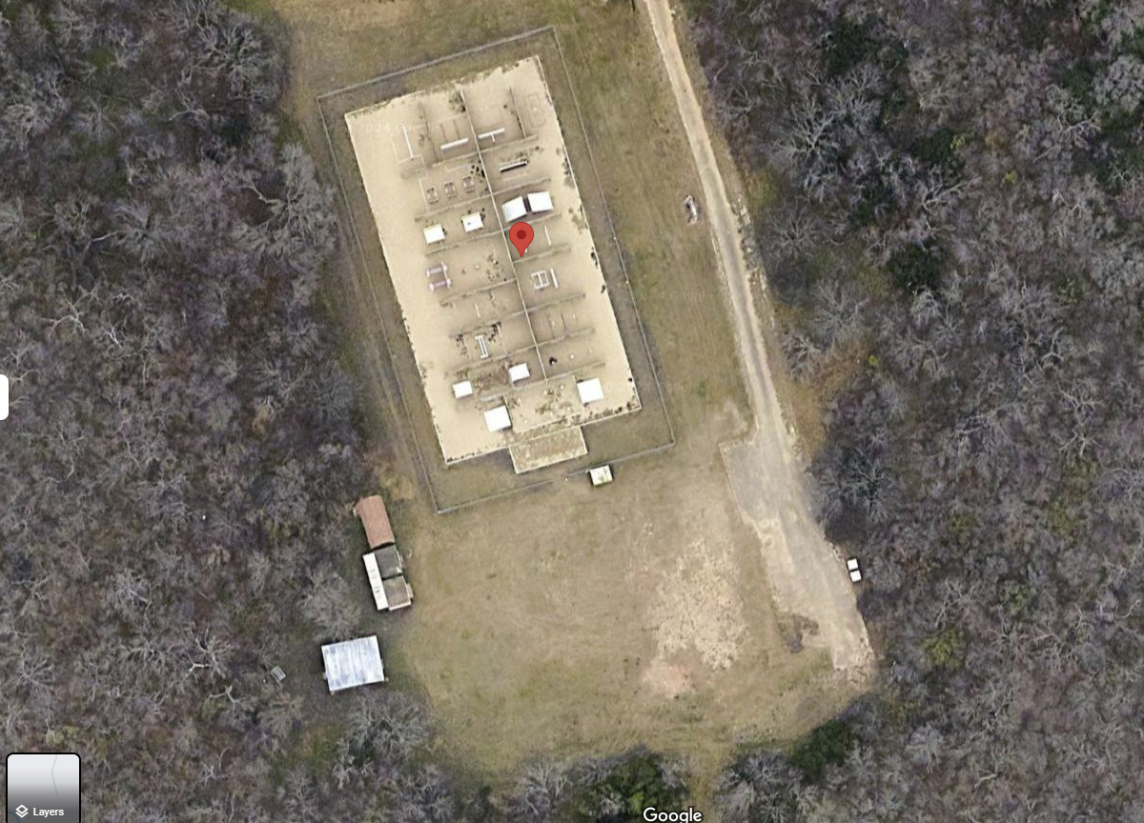
Parking (edit)
Cadet will park in the Red Outlined Area from back to front facing in the direction of arrows
POC in reflective vest will direct you on how to park
POC FC will take accountability upon arrival
Cadets will then form up with their LRC group and await safety briefing without looking at the course
LRC Courses
Air Force ROTC Detachment 842 • We Build Exceptional Officers • The University of Texas at San Antonio

Slide 8
Transition/Groups
A-group will start off execution in their designated station
B-group will start off in break/prep time
An evaluator from your initial station will guide your flight to the station
In transition to your station you will keep your head down and hand on shoulder of cadet in front of you DO NOT LOOK AT THE STATIONS
Air Force ROTC Detachment 842 • We Build Exceptional Officers • The University of Texas at San Antonio

Slide 9
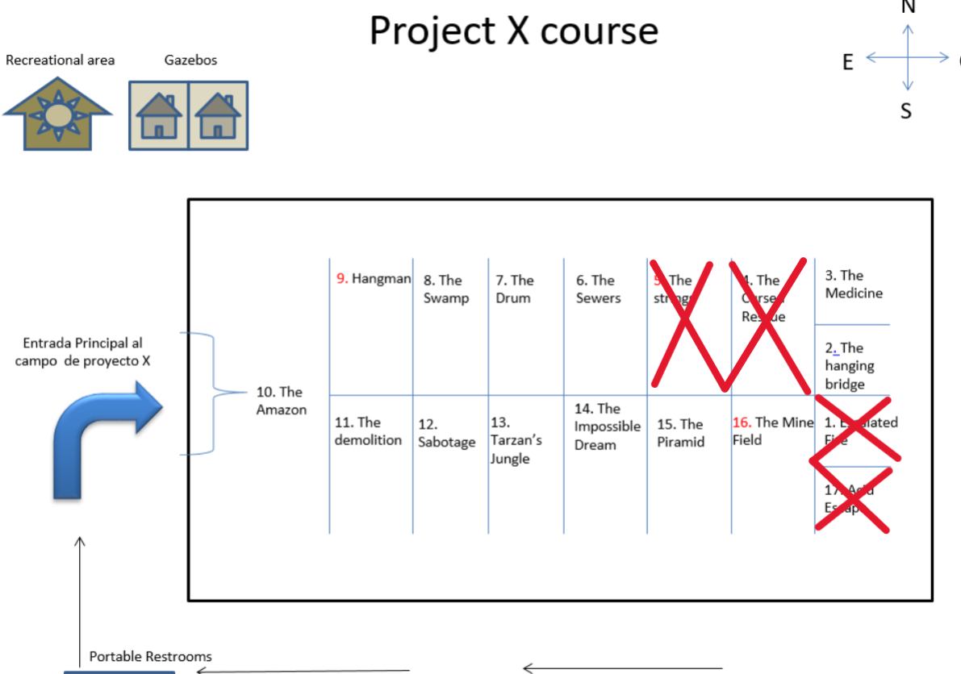
Rotations/Procedure
A Group will arrive at
their designated initial station and upon completion of the station, will transition clockwise but stay off
B group flights will swap into the designated stations after the initial 15 mins and execute while A group swaps out to debrief
Station
9
Station 8
Station 7
Station 6
Station 3
Station 2
Station 10
Skip
Station 12
Station 13
Station 14
Station 15
Station 16
Air Force ROTC Detachment 842 • We Build Exceptional Officers • The University of Texas at San Antonio

Slide 10
UOD
BC/BCL
Det Shirt
Blue Jeans
Black Belt
Tennis Shoes
Black Watch
Black Jacket
Air Force ROTC Detachment 842 • We Build Exceptional Officers • The University of Texas at San Antonio

Slide 11
Safety/Execution
Obstacle courses are not playgrounds
Hydration
3 points of contact (When necessary)
Assigned safeties will wear white or blue (provided at station)
Helmets will be worn at all times
No Jewelry is permitted
Gloves will be worn at all times
Challenge yourself
Air Force ROTC Detachment 842 • We Build Exceptional Officers • The University of Texas at San Antonio

Slide 12
Summary
Timeline
Locations
Required Items
Parking
Transition/Groups
Rotations
UOD
Safety/Execution
Air Force ROTC Detachment 842 • We Build Exceptional Officers • The University of Texas at San Antonio

Slide 13
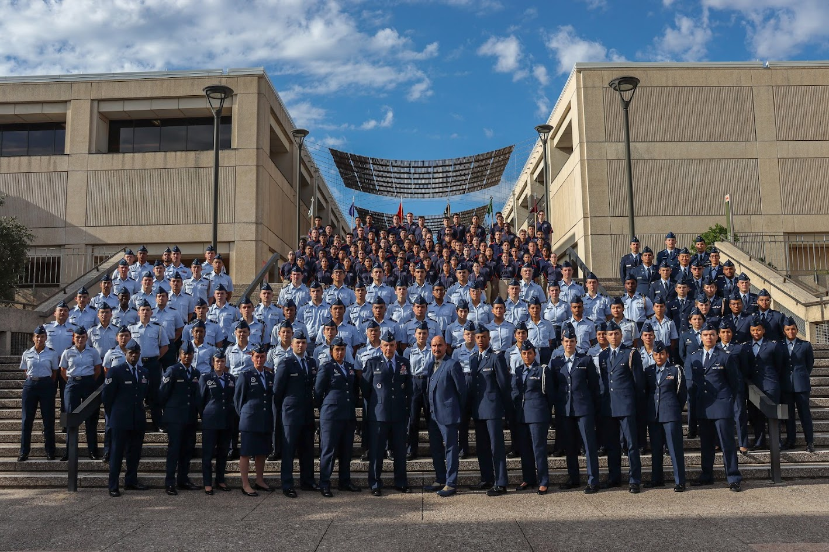
Air Force ROTC Detachment 842
The University of Texas at San Antonio
Det 842 – Best in Blue

